Slide 1
Agenda
Day1 | Fundamentals of Machine Learning: Introduction to Machine Learning and its Applications, Machine Learning Python Tools. Simple machine learning application. Data Preprocessing: Data Sets, importing libraries, Missing Data, Categorical Data, Splitting the Data Set into Training Set and Test Set, Feature Extraction and Preprocessing
Day2 | Types of Machine Learning Algorithms Bayesian Learning: Bayes Theorem and Concept Learning, ML and LS error Hypothesis, Naïve Bayes Classifier, Bayesian belief networks, EM Algorithm
Day 3 | Instance Based Learning: Introduction, K-nearest neighbor learning, locally weighted regression, radial basis function, cased based reasoning. Reinforced Learning: Introduction, Learning Task, Q Learning

Slide 2
Day2

Slide 3
Types of Machine Learning
Supervised Learning – Train Me!
Unsupervised Learning – I am self sufficient in learning
Reinforcement Learning – My life My rules! (Hit & Trial)

Slide 4
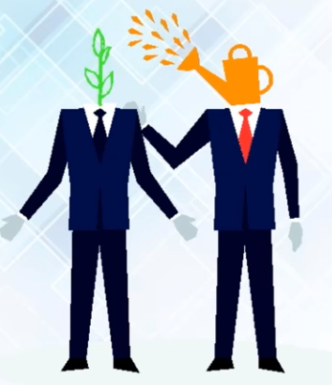

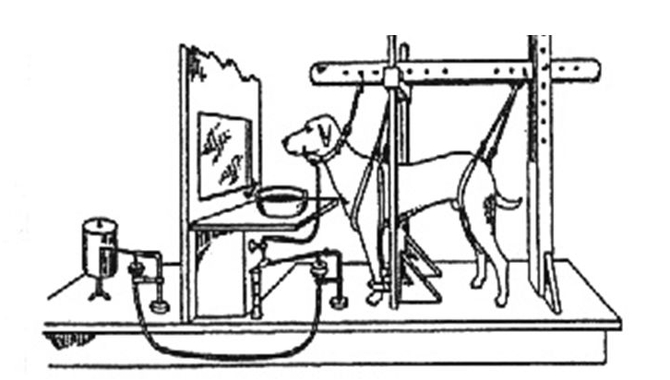
Types of Machine Learning Algorithm
Reinforcement Learning
Supervised Learning
Unsupervised Learning

Slide 5
Types of ML
What is Supervised Learning?
Supervised Learning is the one, where you can consider the learning is guided by a teacher. We have a dataset which acts as a teacher and its role is to train the model or the machine. Once the model gets trained it can start making prediction or decision when new data is given to it.
What is Unsupervised Learning?
The model learns through observation and finds structures in the data. Once the model is given a dataset, it automatically finds patterns and relationships in the dataset by creating clusters in it. What it cannot do is add labels to the cluster, like it cannot say this a group of apples or mangoes, but it will separate all the apples from mangoes.
Suppose we presented images of apples, bananas and mangoes to the model, so what it does, based on some patterns and relationships it creates clusters and divides the dataset into those clusters. Now if a new data is fed to the model, it adds it to one of the created clusters.
What is Reinforcement Learning?
It is the ability of an agent to interact with the environment and find out what is the best outcome. It follows the concept of hit and trial method. The agent is rewarded or penalized with a point for a correct or a wrong answer, and on the basis of the positive reward points gained the model trains itself. And again once trained it gets ready to predict the new data presented to it.

Slide 6
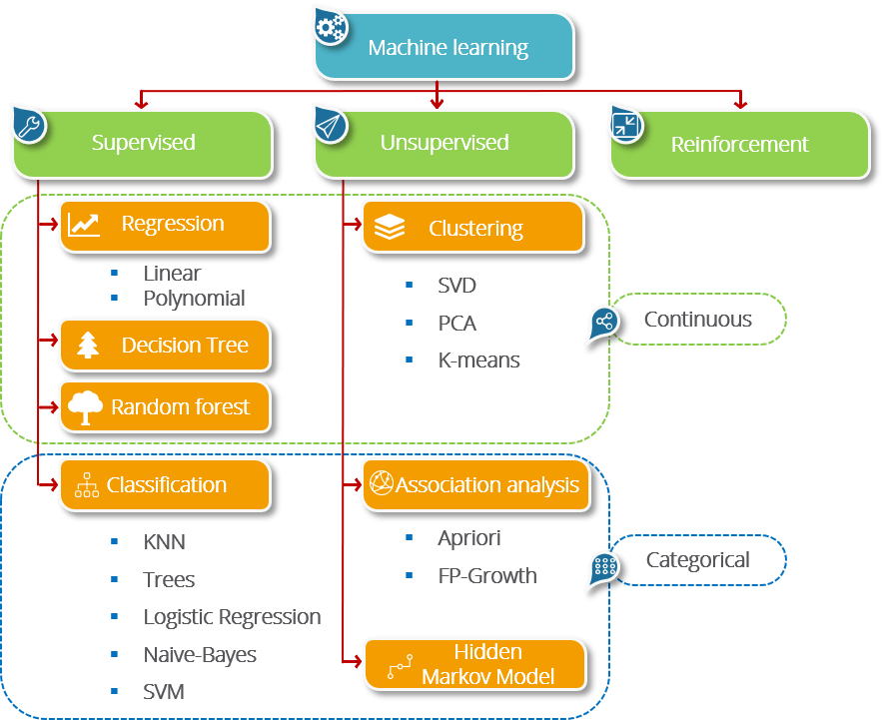

Slide 7
Understanding Supervised Learning
Let’s see the mathematical definition of Supervised Learning.
Supervised learning is the one where you have input variables (x) and an output variable (Y) and you use an algorithm to learn the mapping function from the input to the output. it,
Y = f(X)
The goal is to approximate the mapping function so well that whenever you get some new input data (x), the machine can easily predict the output variables (Y) for that data.

Slide 8
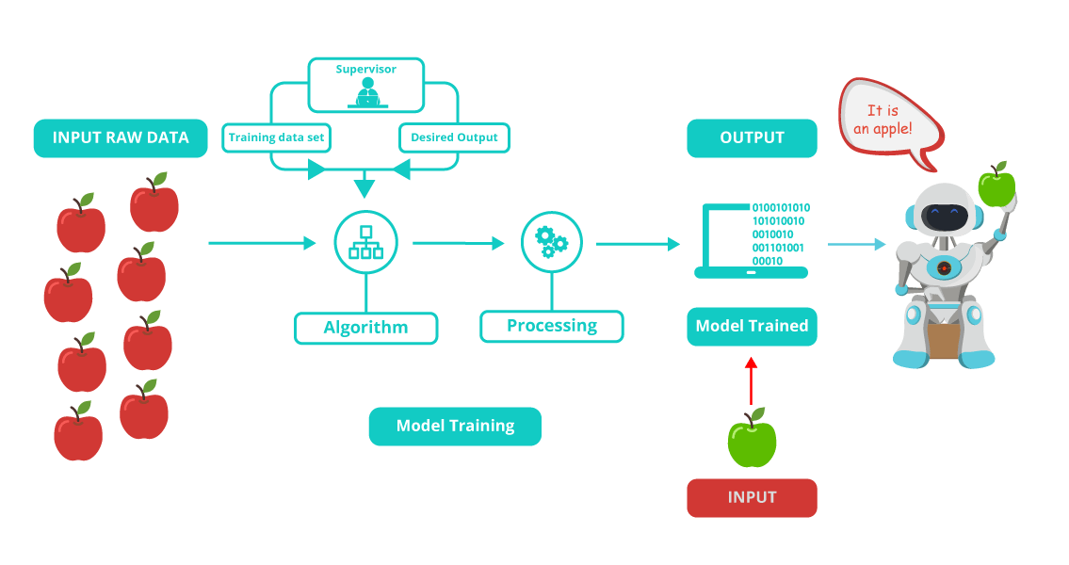

Slide 9
Let me rephrase you this in simple terms:
In Supervised machine learning algorithm, every instance of the training dataset consists of input attributes and expected output. The training dataset can take any kind of data as an input like values of a database row, the pixels of an image, or even an audio frequency histogram.
Now let me tell you why this category of machine learning is termed as supervised learning?
This category is termed as supervised learning because the process of an algorithm learning from the training dataset can be thought of as a teacher teaching his students. The algorithm continuously predicts the result on the basis of training data and is continuously corrected by the teacher. The learning continues until the algorithm achieves an acceptable level of performance.

Slide 10
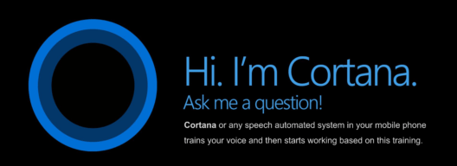
Supervised Learning Use cases
Cortana
Cortana or any speech automated system in your mobile phone trains your voice and then starts working based on this training. This is an application of Supervised Learning

Slide 11
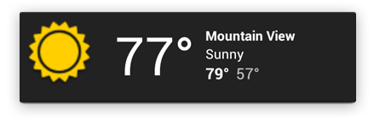
Supervised Learning Use cases
Weather Apps
Predicts the upcoming weather by analyzing the parameters for a given time on some prior knowledge (when its sunny, temperature is higher; when its cloudy, humidity is higher, etc.).

Slide 12
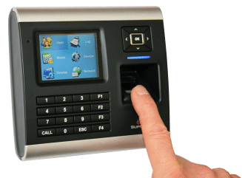
Supervised Learning Use cases
Biometric Attendance
In Biometric Attendance you can train the machine with inputs of your biometric identity – it can be your thumb, iris or ear-lobe, etc. Once the machine is trained it can validate your future input and can easily identify you.

Slide 13
Understanding Unsupervised Learning
So What is Unsupervised Learning?
Mathematically, Unsupervised learning is where you only have input data (X) and no corresponding output variables.
The goal for unsupervised learning is to model the underlying structure or distribution in the data in order to learn more about the data.

Slide 14
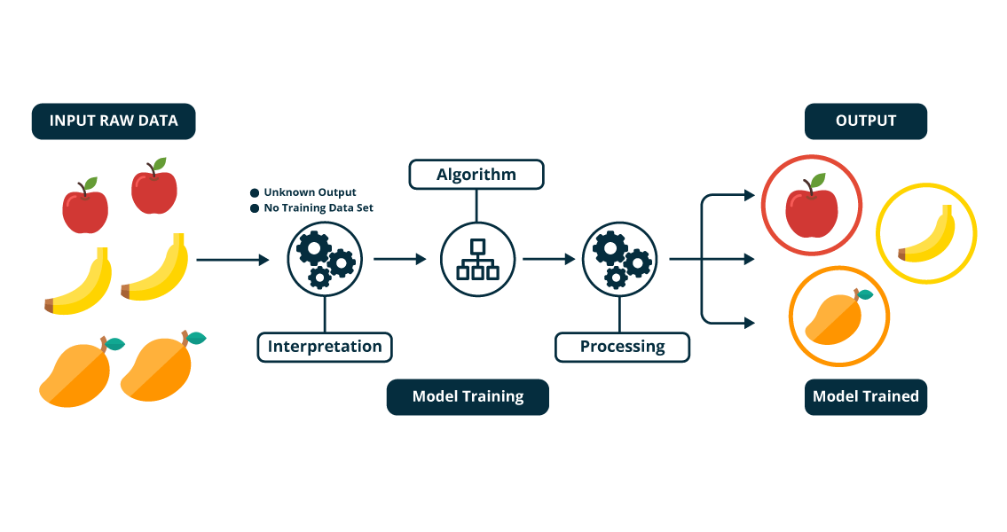

Slide 15
Let me rephrase it for you in simple terms:
In the unsupervised learning approach, the sample of a training dataset does not have an expected output associated with them. Using the unsupervised learning algorithms you can detect patterns based on the typical characteristics of the input data. Clustering can be considered as an example of machine learning task that uses the unsupervised learning approach. The machine then groups similar data samples and identify different clusters within the data.
Now let me tell you why this category of machine learning is known as unsupervised learning?
Well, this category of machine learning is known as unsupervised because unlike supervised learning there is no teacher. Algorithms are left on their own to discover and return the interesting structure in the data.

Slide 16

Unsupervised Learning Usecases
A friend invites you to his party where you meet totally strangers. Now you will classify them using unsupervised learning (no prior knowledge) and this classification can be on the basis of gender, age group, dressing, educational qualification or whatever way you would like. Since you didn’t have any prior knowledge about people and so you just classified them “on-the-go”.

Slide 17
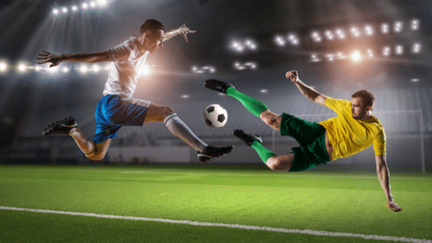
Unsupervised Learning Usecases
Let’s suppose you have never seen a Football match before and by chance watch a video on internet, now you can classify players on the basis of different criterion like Players wearing the same sort of kits are in one class, Players of one style are in one class (players, goalkeeper, referee), or on the basis of playing style(attacker or defender) or whatever way you would observe, you can classify it.

Slide 18
Understanding Reinforcement Learning
So what is Reinforcement Learning?
Reinforcement learning can be thought of as a hit and trial method of learning. The machine gets a Reward or Penalty point for each action it performs. If the option is correct, the machine gains the reward point or gets a penalty point in case of a wrong response.

Slide 19
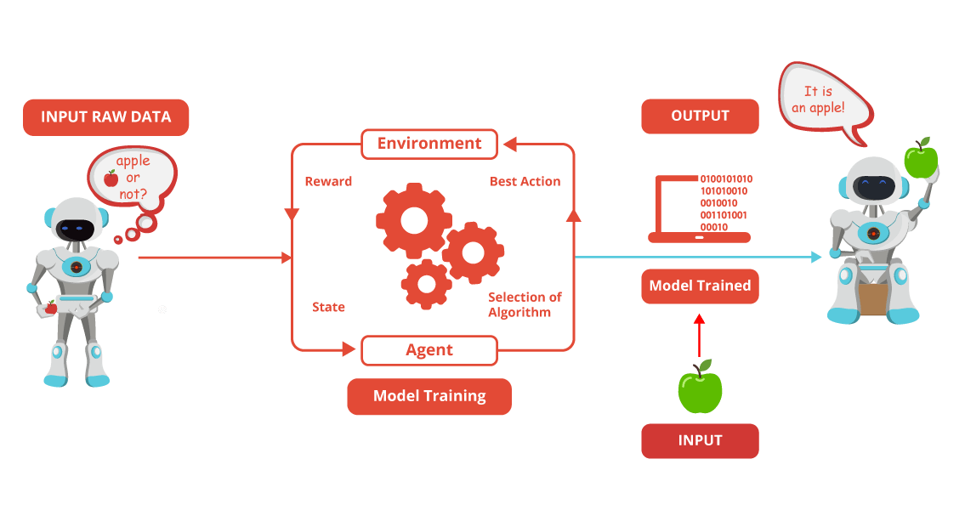

Slide 20
The reinforcement learning algorithm is all about the interaction between the environment and the learning agent. The learning agent is based on exploration and exploitation.
Exploration is when the learning agent acts on trial and error and Exploitation is when it performs an action based on the knowledge gained from the environment. The environment rewards the agent for every correct action, which is the reinforcement signal. With the aim of collecting more rewards obtained, the agent improves its environment knowledge to choose or perform the next action.

Slide 21
Let see how Pavlov trained his dog using reinforcement training?
Pavlov divided the training of his dog into four stages.
In the first part, Pavlov gave meat to the dog, and in response to the meat, the dog started salivating.
In the next stage he created a sound with a bell, but this time the dogs did not respond anything.
In the third stage, he tried to train his dog by using the bell and then giving them food. Seeing the food the dog started salivating.
Eventually, the dogs started salivating just after hearing the bell, even if the food was not given as the dog was reinforced that whenever the master will ring the bell, he will get the food.

Slide 22
